Slide 1
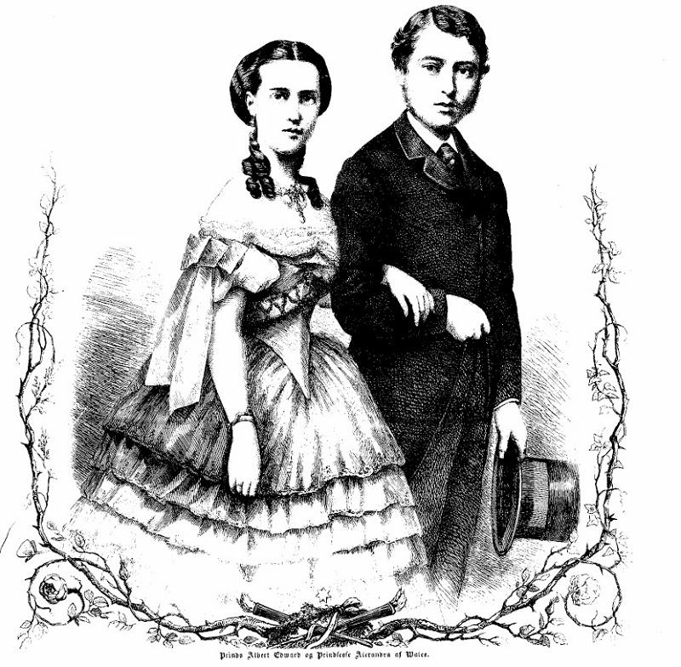
Alexandra

Slide 2
Christian 9. & Louise
Frederik 3. juni 1843
Alexandra 1. december 1844
Vilhelm 24. december 1845
Dagmar 26. november 1847
Thyra 29. september 1853
Valdemar 27. oktober 1858

Slide 3
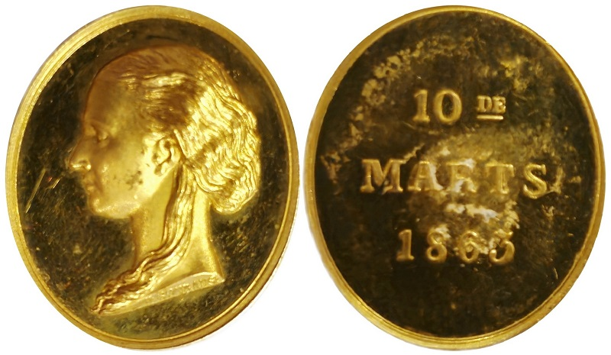
Alexandra

Slide 4
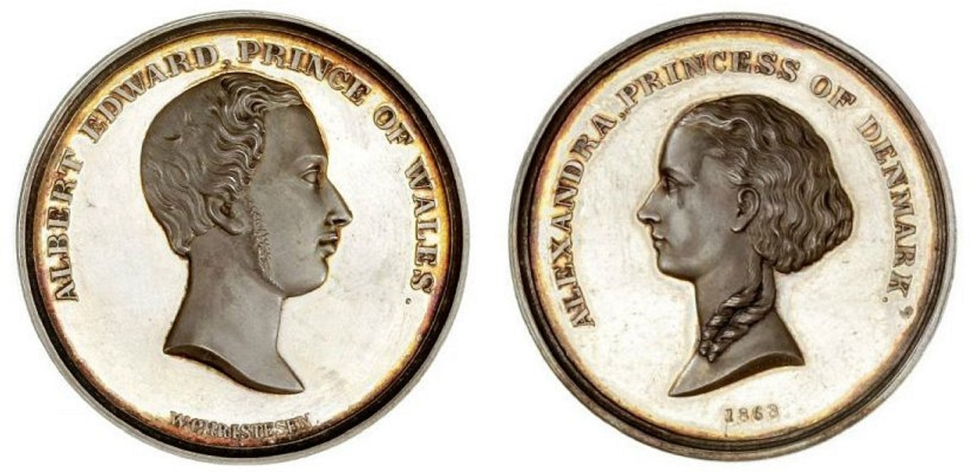
Alexandra

Slide 5
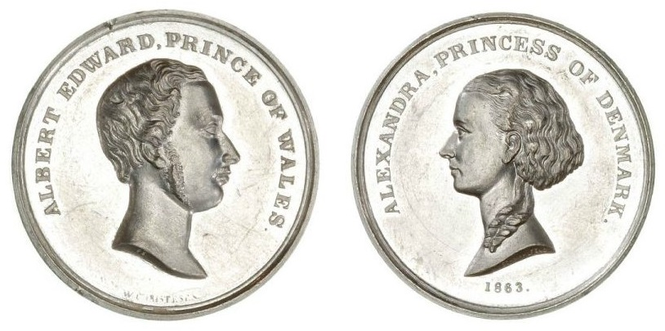
Alexandra

Slide 6
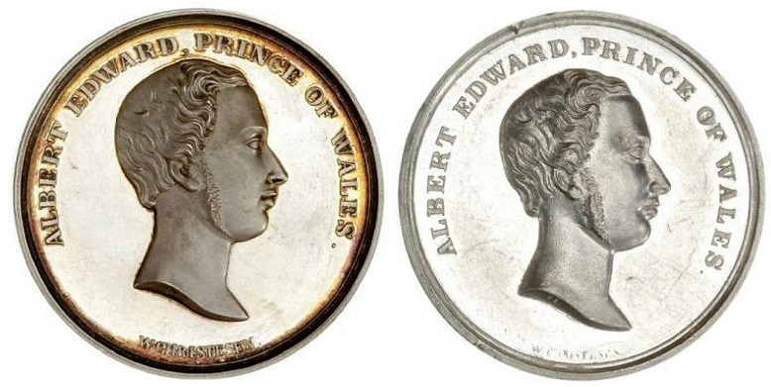
Alexandra

Slide 7
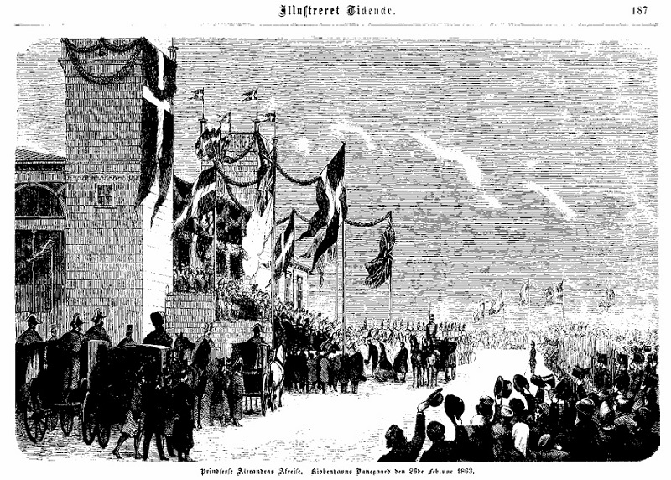
Alexandra

Slide 8
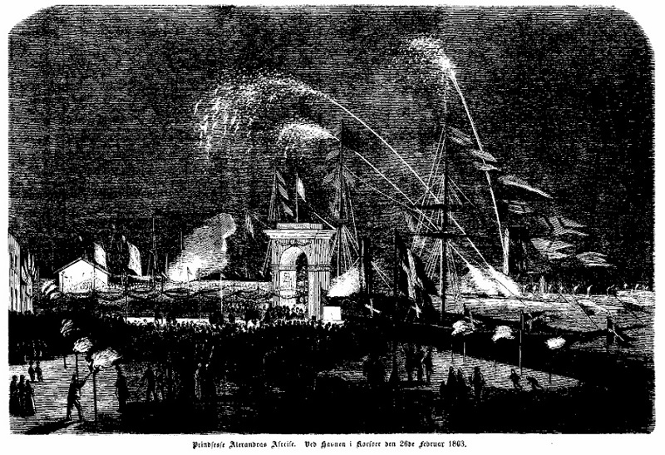
Alexandra

Slide 9
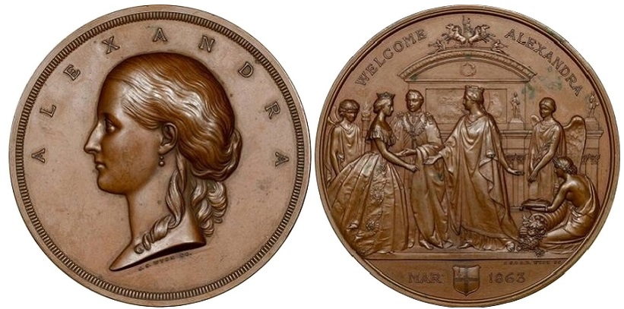
Alexandra

Slide 10
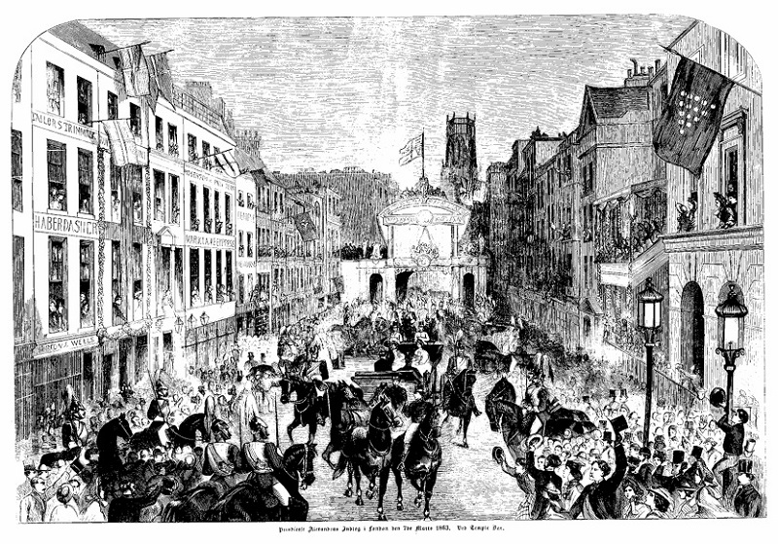
Alexandra

Slide 11
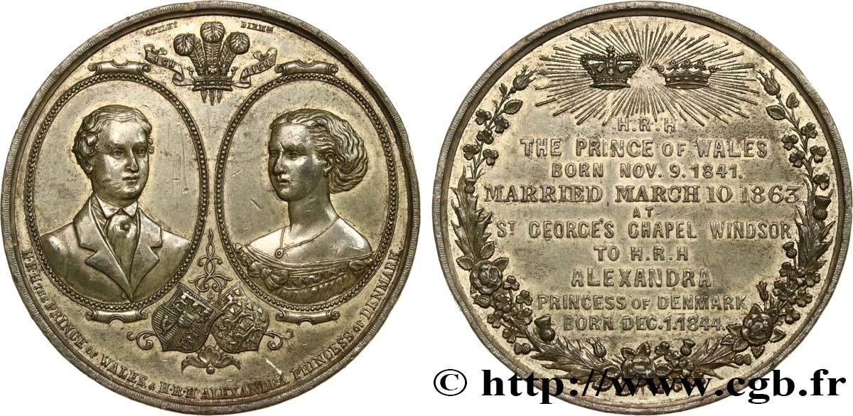
Alexandra

Slide 12
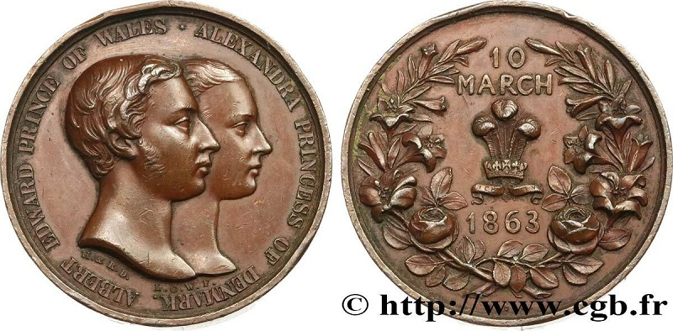
Alexandra

Slide 13
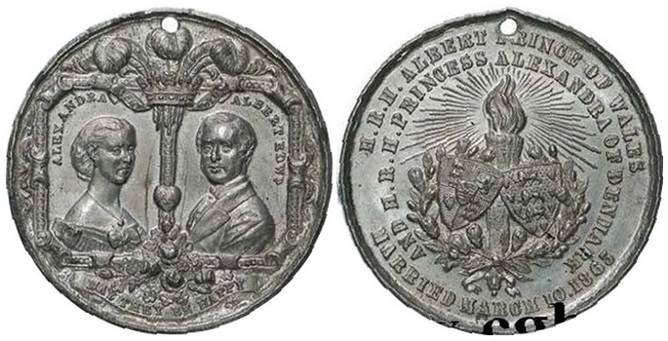
Alexandra

Slide 14
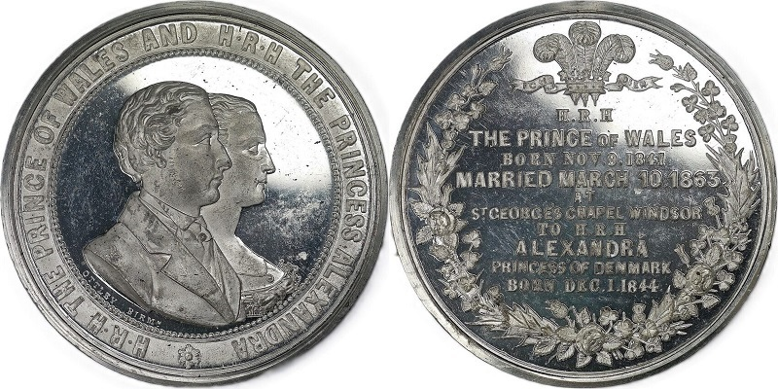
Alexandra

Slide 15
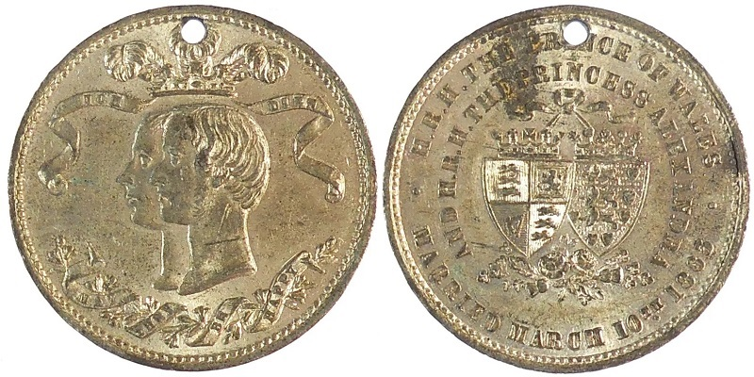
Alexandra

Slide 16
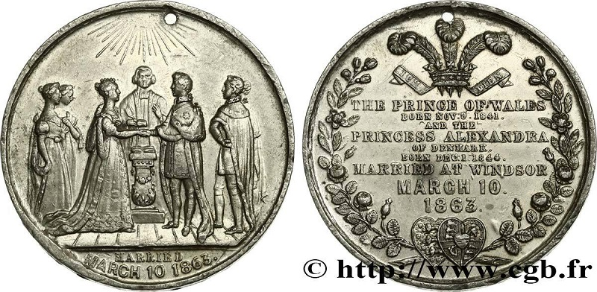
Alexandra

Slide 17
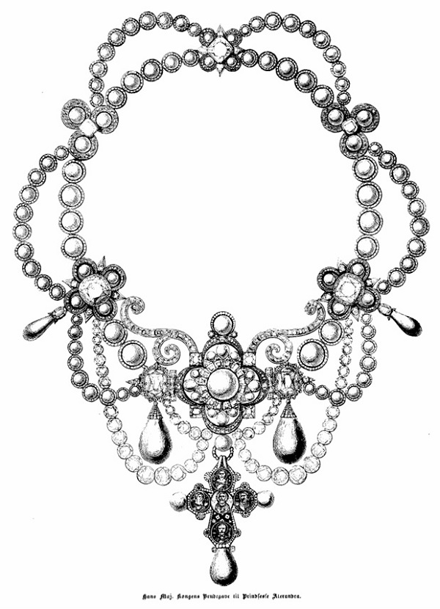
Alexandra

Slide 18
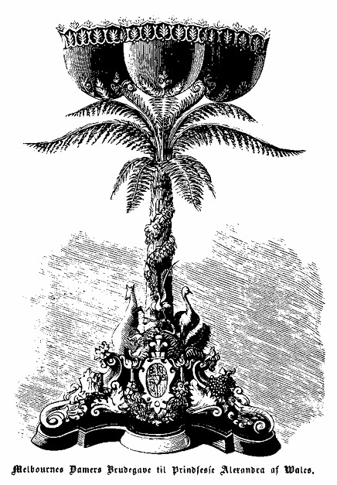
Alexandra

Slide 19
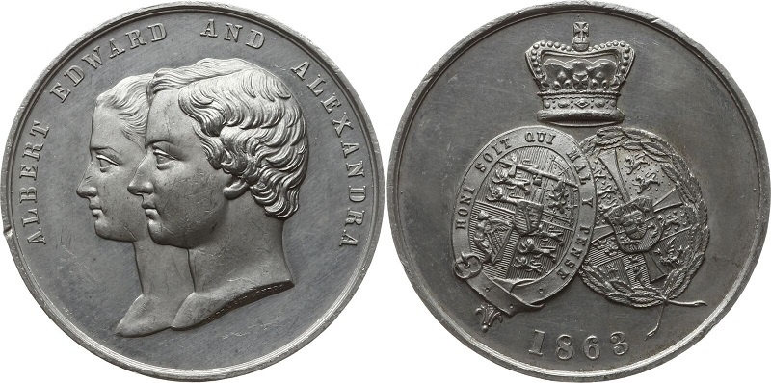
Alexandra

Slide 20
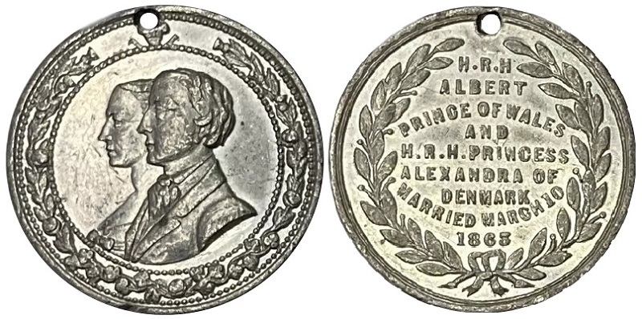
Alexandra

Slide 21
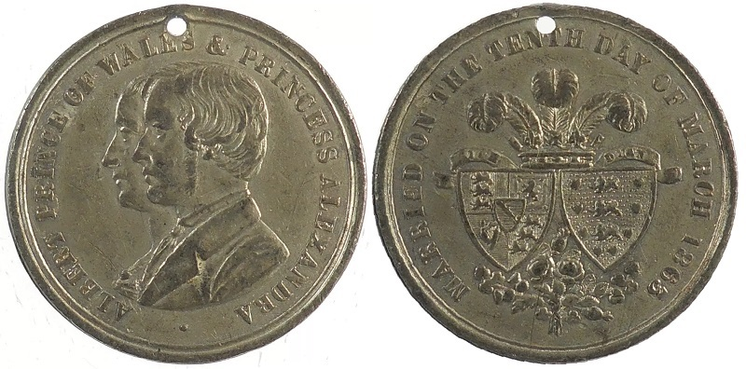
Alexandra

Slide 22
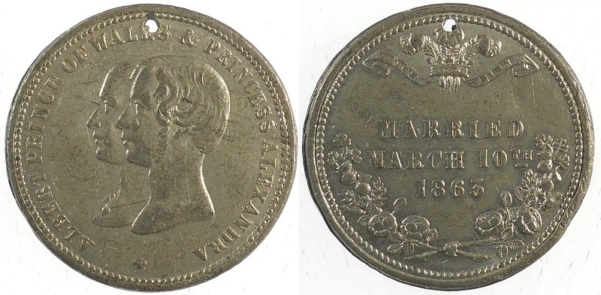
Alexandra

Slide 23
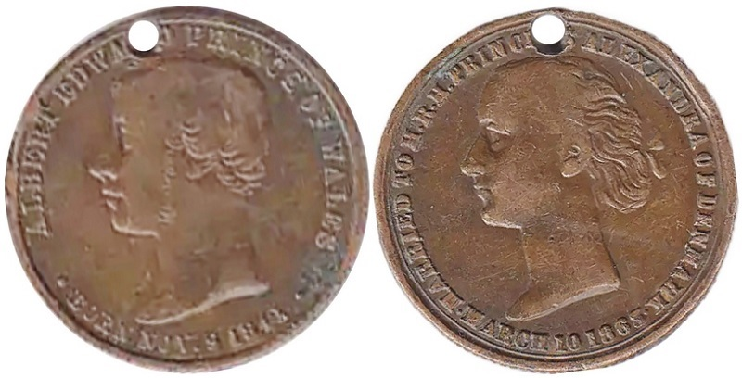
Alexandra

Slide 24
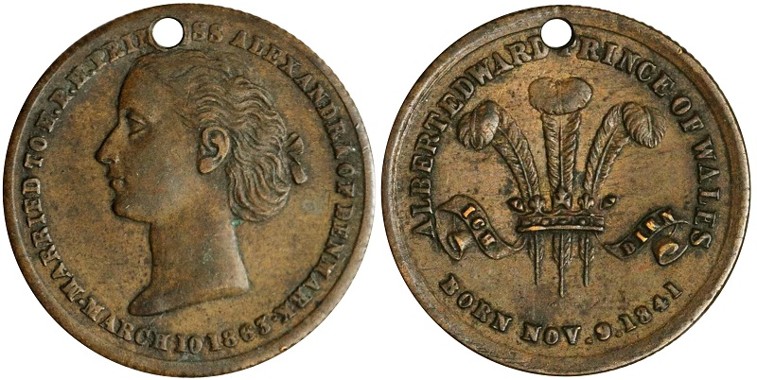
Alexandra

Slide 25
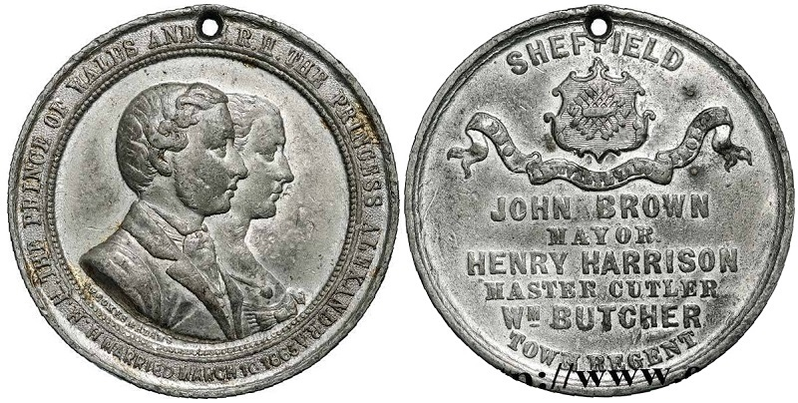
Alexandra

Slide 26
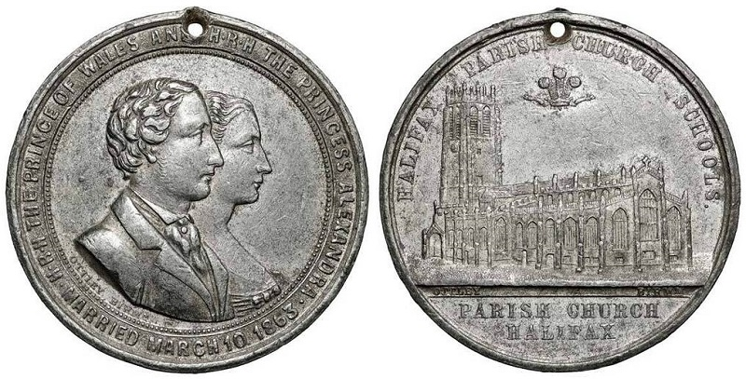
Alexandra

Slide 27
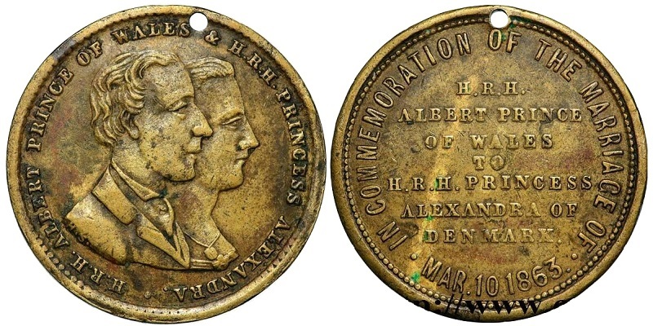
Alexandra

Slide 28
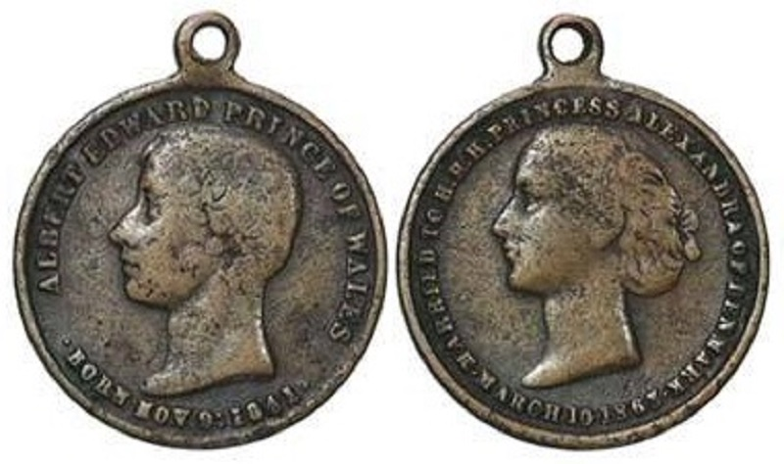
Alexandra

Slide 29
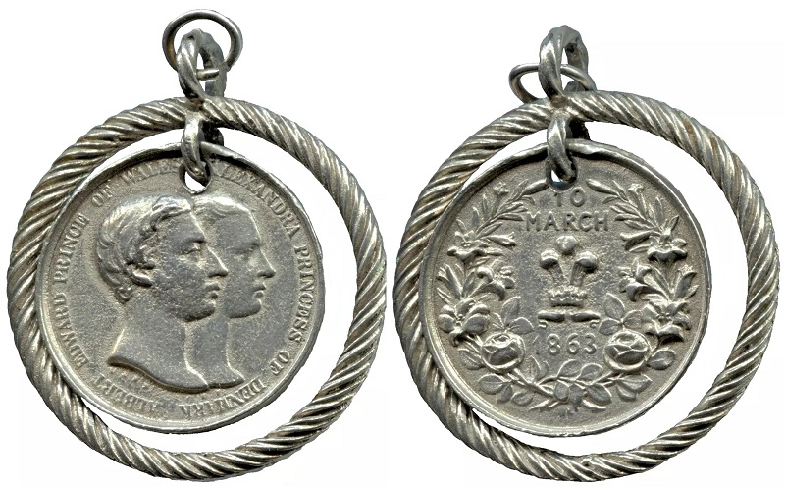
Alexandra

Slide 30
Alexandra Carolina Marie Charlotte Louise Julia
1. december 1844
20. november 1925

Slide 31
Alexandra
Albert Victor 1864 - 1892
Georg 1865 - 1939
Louise 1867 - 1931
Victoria 1868 - 1935
Maud 1869 - 1938
Alexander John 1871

